Slide 1
Polling Server (incl. Introduction to fixed priority servers)
Hochschule hamm-lippstadt University of Applied Science
Real Time System Prof. Stefan Henkler
Group: A
Md Azadul Islam

Slide 2
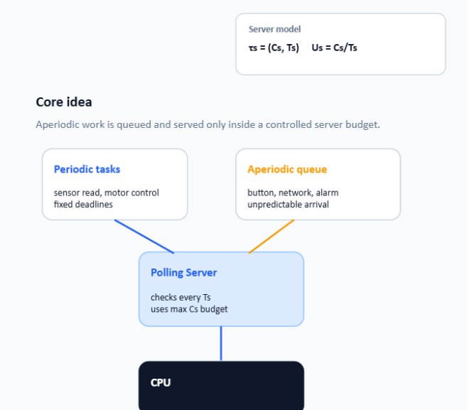
Motivation: Why Polling Server ?
A real-time system is a system where tasks must produce the correct result within a specific time deadline.
What does polling server do:
A pollinng server provides a controlled way to serve aperiodic requiest.
It reserves limited CPU capacity (Cs) every server period (Ts).
If these sudden requests use the CPU without control, hard periodic tasks may miss their deadlines.
Generated by Chatgpt

Slide 3
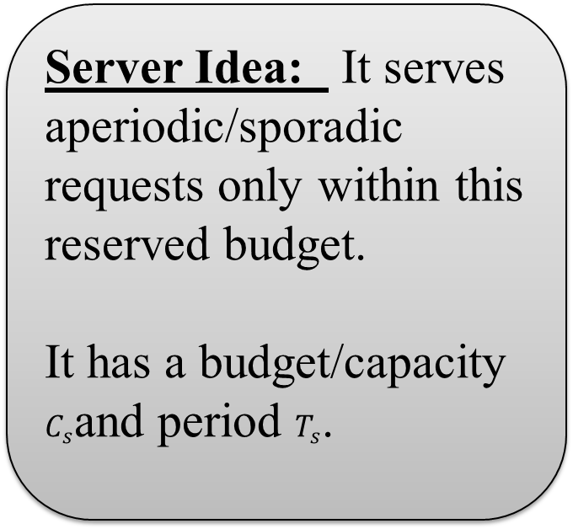
Introduction of Fixed Priority Server
Fixed-priority servers are used to execute non-periodic requests without disturbing hard periodic tasks.
Soft Aperiodic Task: No strick deadline, but fast response preferred
Server Idea: It serves aperiodic/sporadic requests only within this reserved budget.
It has a budget/capacity $C_{s}$and period $T_{s}$.
Sporodic Task: Arrive irregularely, but have a minimum inter arrival time.
Firm Aperiodic Task: Result is useful only before deadline; late result is discarded.

Slide 4
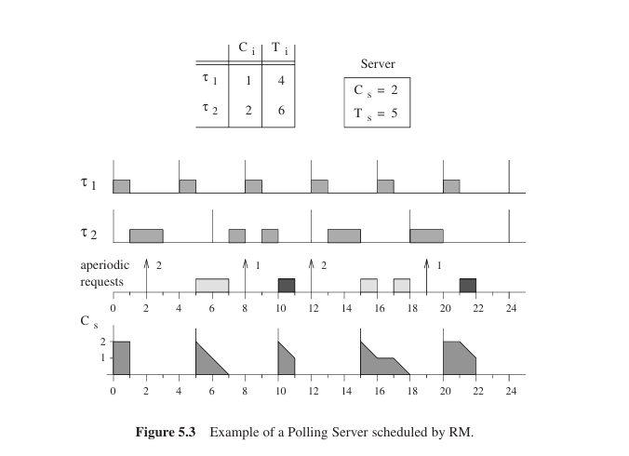
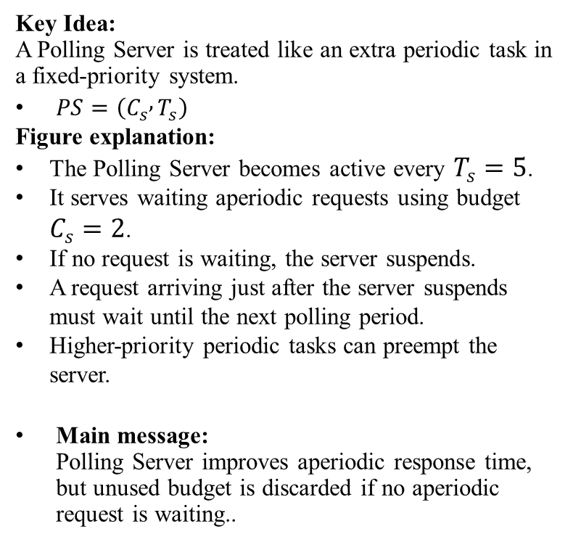
Polling Server Concept
Key Idea: A Polling Server is treated like an extra periodic task in a fixed-priority system.
$PS=\left(C_{s} , T_{s}\right)$
Figure explanation:
The Polling Server becomes active every $T_{s}=5$.
It serves waiting aperiodic requests using budget $C_{s}=2$.
If no request is waiting, the server suspends.
A request arriving just after the server suspends must wait until the next polling period.
Higher-priority periodic tasks can preempt the server.
Main message: Polling Server improves aperiodic response time, but unused budget is discarded if no aperiodic request is waiting..
Source: Buttazzo, Hard Real-Time Computing Systems

Slide 5
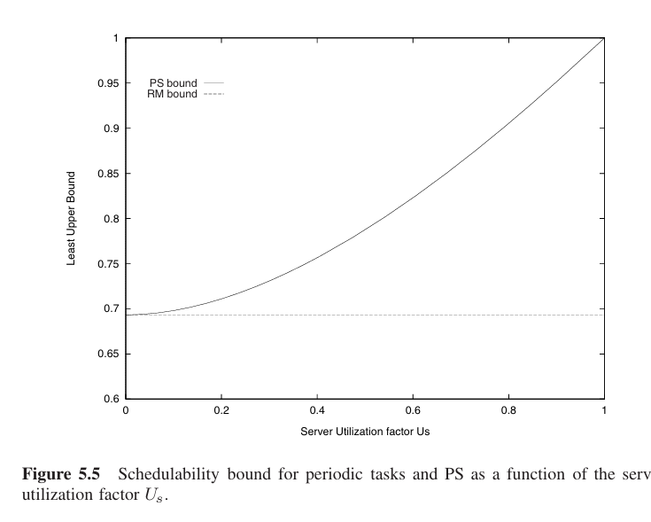
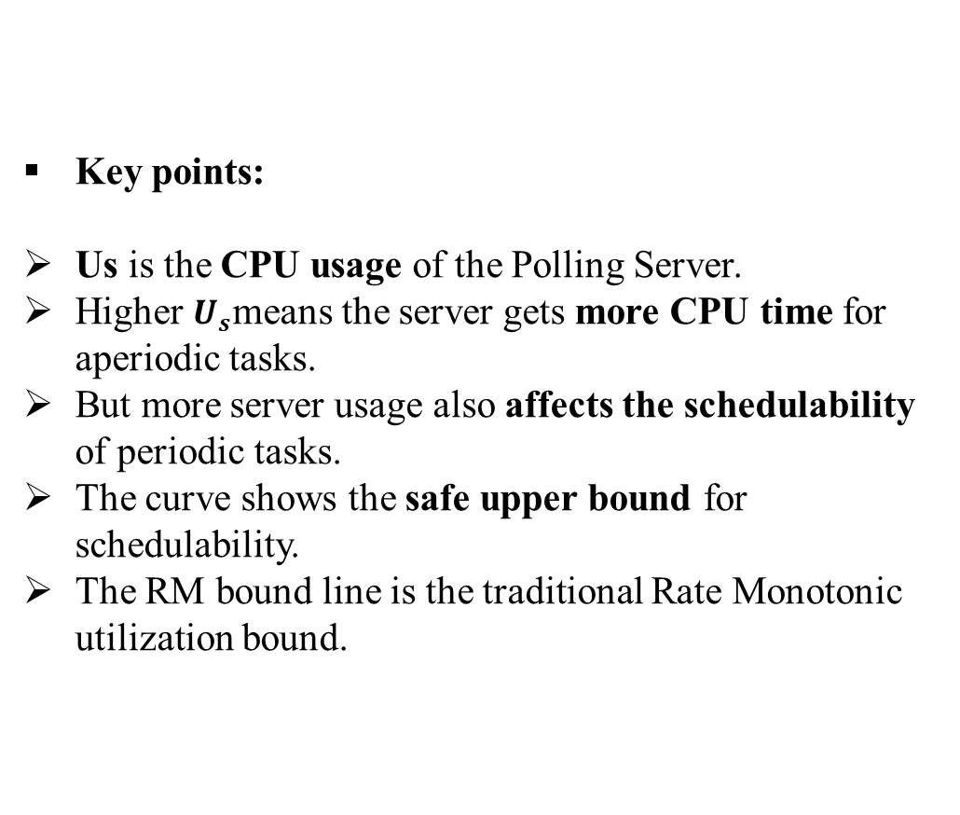
Schedulability Analysis
Key points:
Us​ is the CPU usage of the Polling Server.
Higher $U_{s}$means the server gets more CPU time for aperiodic tasks.
But more server usage also affects the schedulability of periodic tasks.
The curve shows the safe upper bound for schedulability.
The RM bound line is the traditional Rate Monotonic utilization bound.
Checking wether the hard periodic task are still safe when we add polling server for aperiodic request is called Schedulability Analysis ​​
Source: Buttazzo, Hard Real-Time Computing Systems

Slide 6



Dimentioning the Polling Server
Dimentioning means choosing Cs and Ts carefully
Main Idea:
Larger Cs- more execution time for aperiodic task
Smaller Ts- Server is activated more often
Higher Us improves aperiodic response time
Us = Cs/Ts
P represents the schedulability load of all periodic tasks.
Us is server utilization
Hence

Slide 7
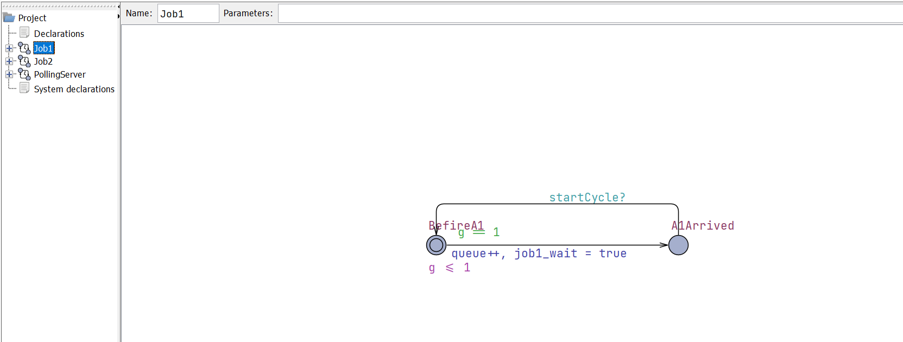
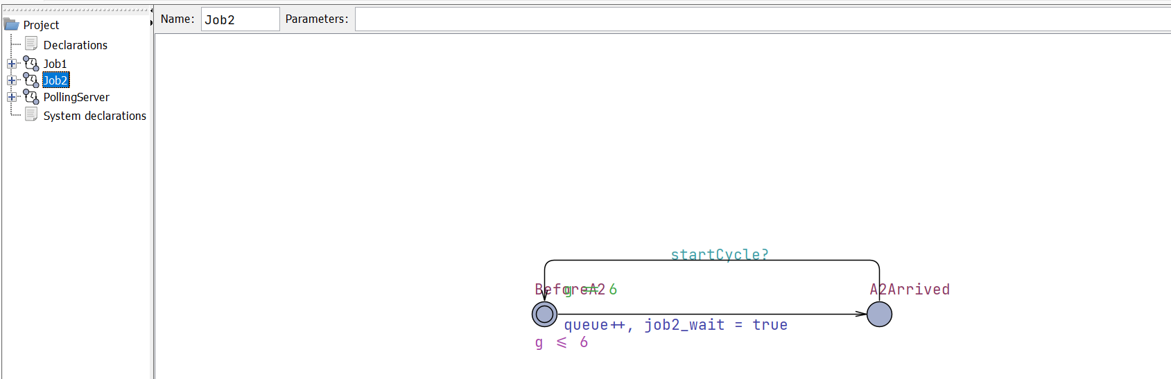
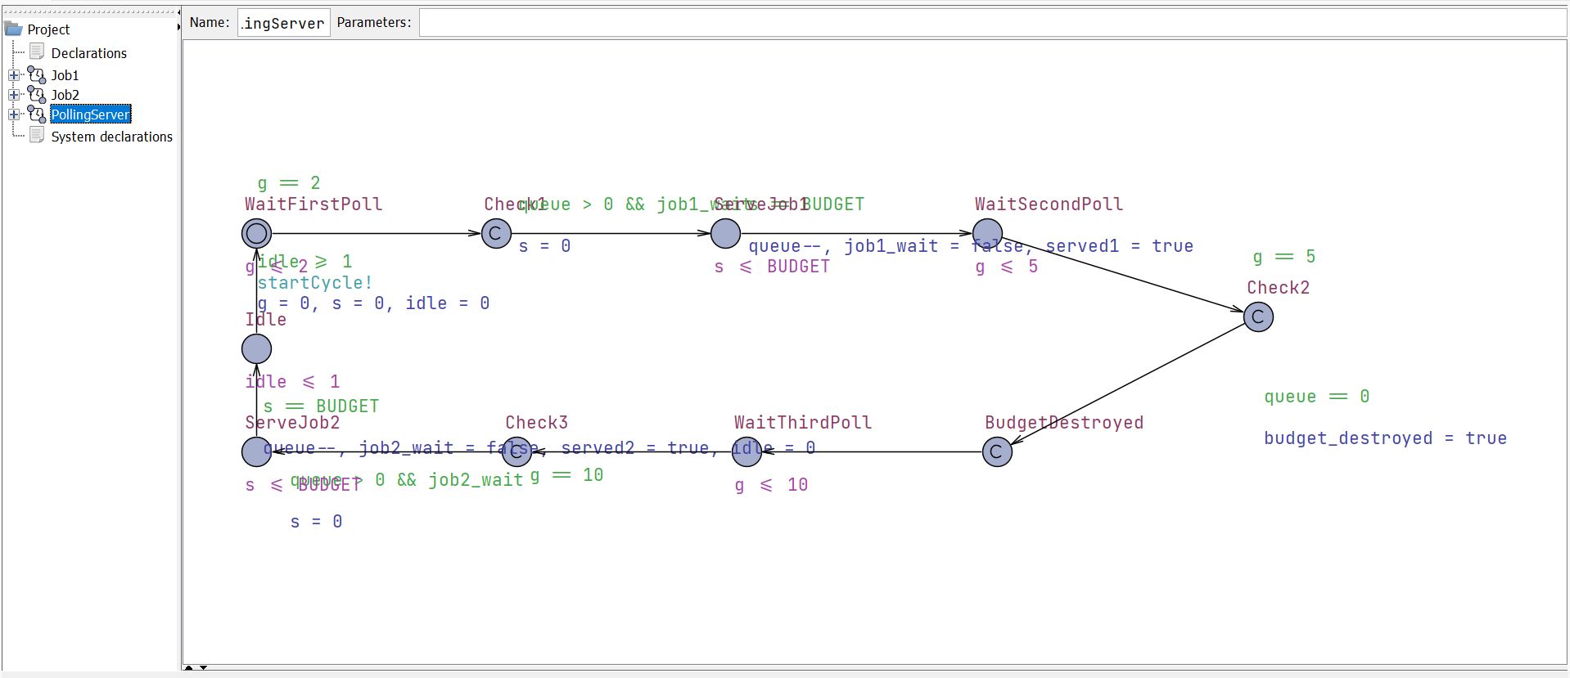
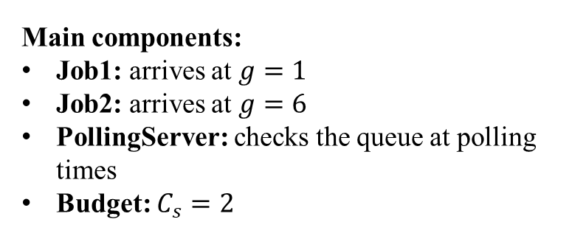
Uppaal Model of polling server
Main components:
Job1: arrives at $g=1$
Job2: arrives at $g=6$
PollingServer: checks the queue at polling times
Budget: $C_{s}=2$
Model Behavior
Job1 arrives early and is served at the first poll.
At the second poll, no job is waiting, so the budget is lost.
Job2 arrives later and waits for the next poll.

Slide 8
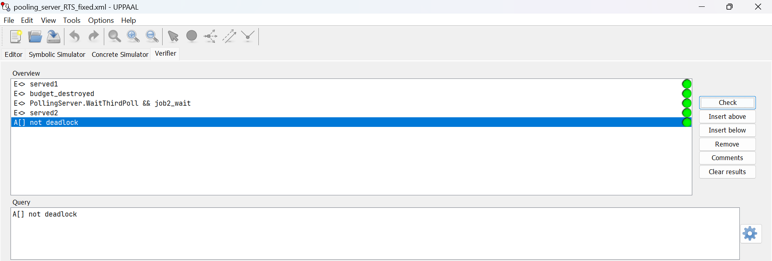
Uppaal model verification
Verified Properties
A[] not deadlock-The model runs continuously without deadlock.
E<> served1- Job1 can be served.
E<> budget_destroyed- Unused server budget can be lost.
E<> PollingServer.WaitThirdPoll && job2_wait- Job2 can wait until the next polling cycle.
E<> served2- Job2 can be served later.
Result: All queries are satisfied. This confirms that the model correctly shows Polling Server behavior

Slide 9
Limitations of Polling Server
Limitations:
Checks requests only at polling times.
Late arrivals wait until the next period.
Unused budget is lost.

Slide 10
Conclusion
Polling Server handles aperiodic requests in a controlled way.
Hard periodic tasks remain protected.
UPPAAL model shows how aperiodic tasks has been served by polling server.
Final message: Polling Server improves aperiodic response time while keeping periodic tasks schedulable.

Slide 11
References & AI Usage
References:
Buttazzo, G. C. (2011). Hard Real-Time Computing Systems: Predictable Scheduling Algorithms and Applications (3rd ed.). Springer.
Own UPPAAL model: Polling Server RTS fixed.xml, created and verified in UPPAAL.
AI Usage
OpenAI ChatGPT was used to support explanation, slide wording, summarization, and slide image generation.
The technical content, UPPAAL model, verification results, and final interpretation were reviewed and adapted by the author.
AI tool citation
OpenAI. (2026). ChatGPT [Large language model]. Used on 21 June 2026.

Slide 12
Thank you

